Slide 1
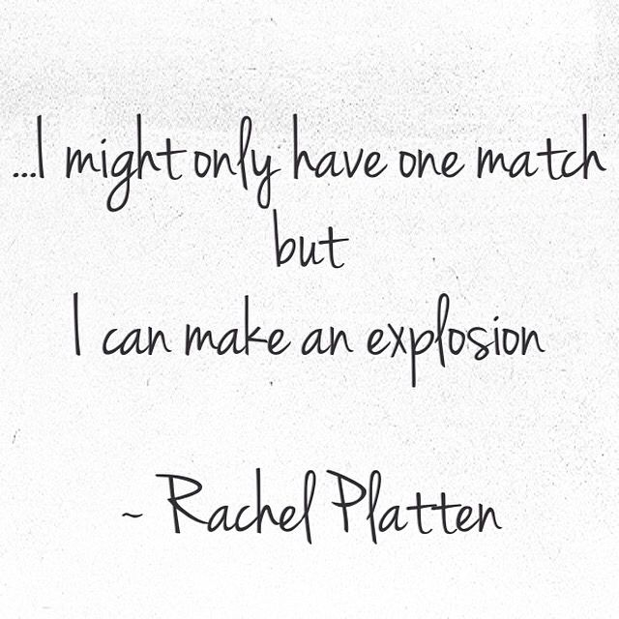

Association mining of music and text
Presenter: Peiran FANG

Slide 2
Feature EXTRACTION
Mean
Standard Deviation
Median
Total: 45 features (15 * 3)

Slide 3
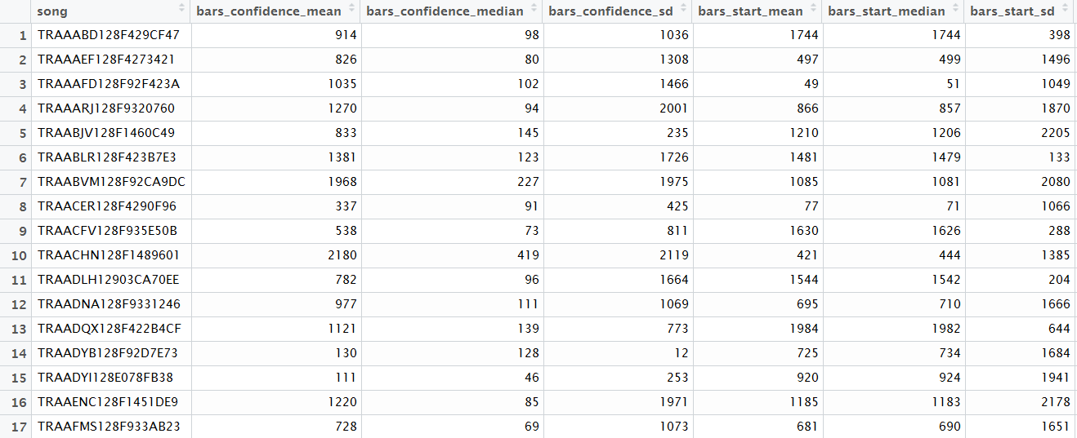
Feature EXTRACTION

Slide 4
Model 1: Recommendation System
Assumption: Songs with similar musical features are likely to have similar lyrics
Measure dissimilarity by distance in feature space
Minimize the distance between a new song and existing 2350 songs
The minimizer’s word ranking will be used as the new song’s ranking

Slide 5
Result
Distance Measure | Euclidean | Maximum | Manhattan | Canberra | Binary | Minkowski
Prediction difference | 48.06982 | 47.87600 | 48.08213 | 47.99564 | 42.97798 | 48.06982
2300 existing songs, 50 testing songs
Prediction difference is the difference between predicted word distribution and true word distribution
Interesting finding: Binary distance is the best distance measure

Slide 6
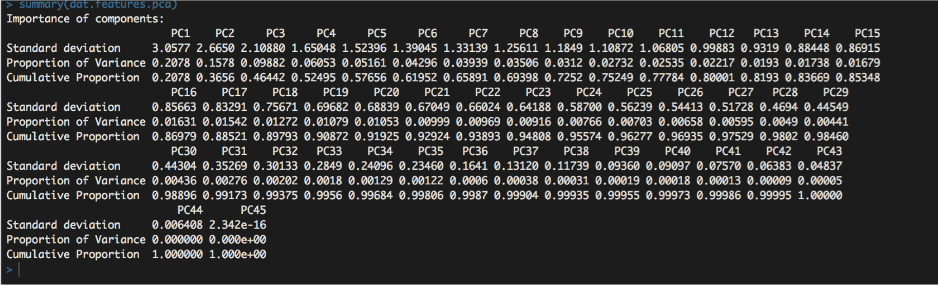
Model 2: Random forest
Motivation
Dimension Reduction (PCA): reduce to 19 features

Slide 7
Model 2: Random forest
50 testing songs, 2300 training songs
For each word, train Random Forest classifier (0, non-exist; 1, exist)
So, there are ~5000 Random Forest classifiers
To predict the rank of each word, we calculate the proportion of trees in a random forest that vote 1 for the word
The higher the number of votes is, the higher the rank is

Slide 8
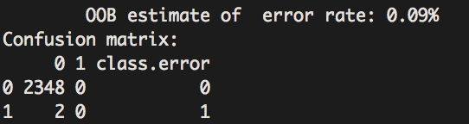
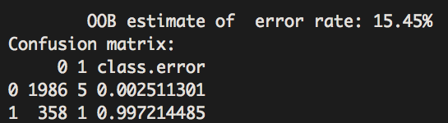
Problem: Unbalanced data
Word: “aaah” (unbalanced)
Word: “about” (relatively balanced)
Possible solution: Cascade

